Slide 1
瞭解 XAML 資料繫結與控制項範本
簡報者

Slide 2
資料繫結（Data Binding）簡介
Compiled binding
控制項範本

Slide 3

資料繫結（Data Binding）簡介

Slide 4
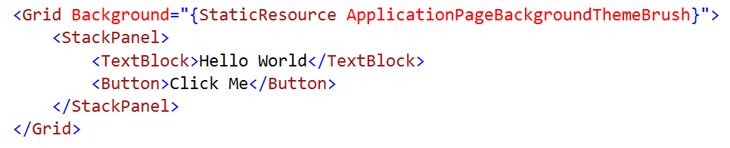
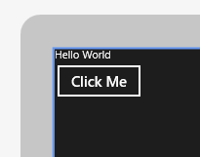
靜態內容
在 XAML 中直接寫入資料很方便…
但這樣做就失去了彈性

Slide 5
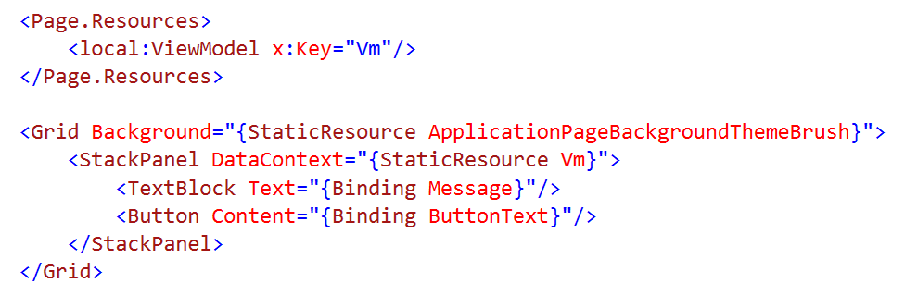
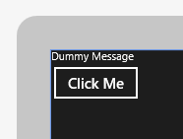
動態資料
改用資料繫結的方式將內容連結至資料來源
常見而典型的資料來源通常是 view model

Slide 6
資料改變時的畫面更新
INotifyPropertyChanged
在 view model 的類別中需實做這個介面
這樣一來，view model 內的資料更新時才會通知畫面更新
INotifyCollectionChanged
在 ObservableCollection<T> 及 ReadOnlyObservableCollection<T> 已實作
當容器內的資料改變時，也會通知畫面更新
(IObservableVector 也相同)

Slide 7
資料繫結的語法
<TextBox Text="{Binding
Converter
ConverterLanguage
ConverterParameter
ElementName
FallbackValue
Mode
Path
RelativeSource
Source
TargetNullValue
UpdateSourceTrigger}

Slide 8
資料格式轉換
資料繫結時，轉換器（converter）可以修改資料格式
原始資料 > 轉換器 > 格式化後的字串
實作 IValueConverter 介面
Convert 方法
Converts data to a new format/value before assignment
ConvertBack 方法
Converts data from the new format/value updating source
Often not implemented

Slide 9
Classic binding

Slide 10
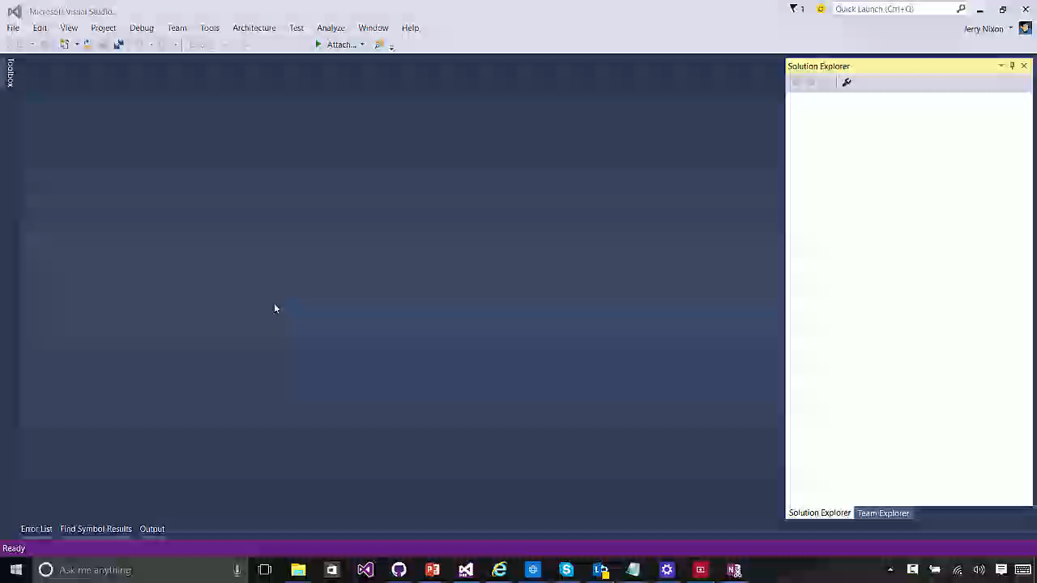

Slide 11
Data bind to models or data bind to elements

Slide 12
ElementName

Slide 13
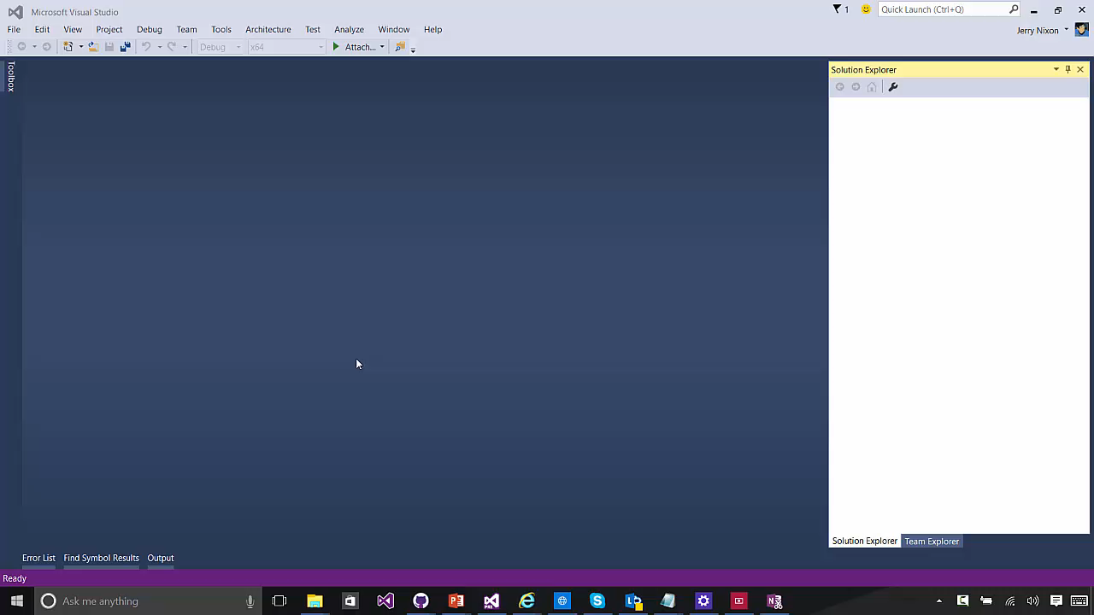

Slide 14

Compiled binding

Slide 15
What problem are we solving?

Slide 16
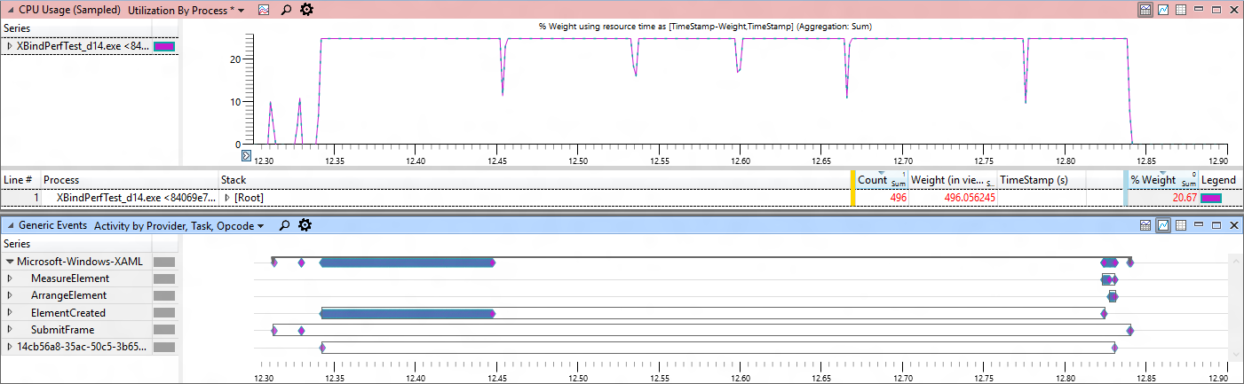
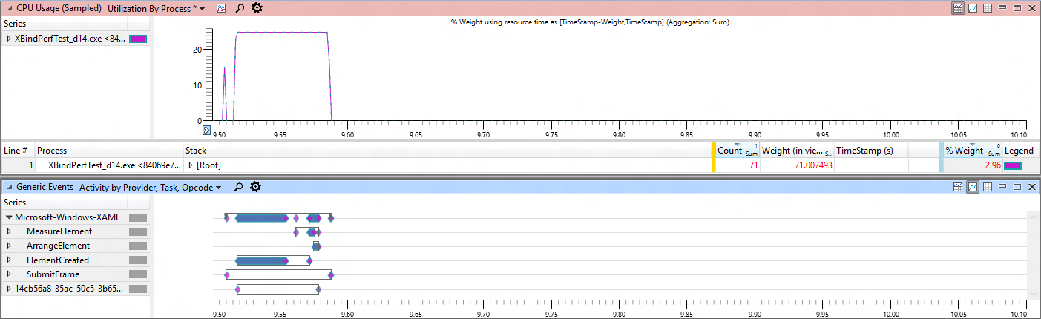
Classic Binding
Compiled Binding

Slide 17
x:Bind
Compiled binding
Bindings are committed at compile-time
Strongly-typed binding
Duck binding is not supported
Default mode is OneTime
OneWay and TwoWay are still available
Standard binding approaches
INotifyPropertyChanged, IObservableVector, INotifyCollectionChanged

Slide 18
The data context of x:Bind is the code-behind class

Slide 19
Syntax
<TextBox Text="{Binding
Converter
ConverterLanguage
ConverterParameter
ElementName
FallbackValue
Mode
Path
RelativeSource
Source
TargetNullValue
UpdateSourceTrigger}
<TextBox Text="{x:Bind
Converter
ConverterLanguage
ConverterParameter
ElementName
FallbackValue
Mode
Path
RelativeSource
Source
TargetNullValue
UpdateSourceTrigger}

Slide 20
Data Templates
<ListView ItemsSource="{x:Bind ViewModel.Employees}">
<ListView.ItemTemplate>
<DataTemplate x:DataType="model:Employee">
<Grid>
<TextBlock Text="{x:Bind Name}"/>
</Grid>
</DataTemplate>
</ListView.ItemTemplate>
</ListView>

Slide 21
Compiled binding

Slide 22
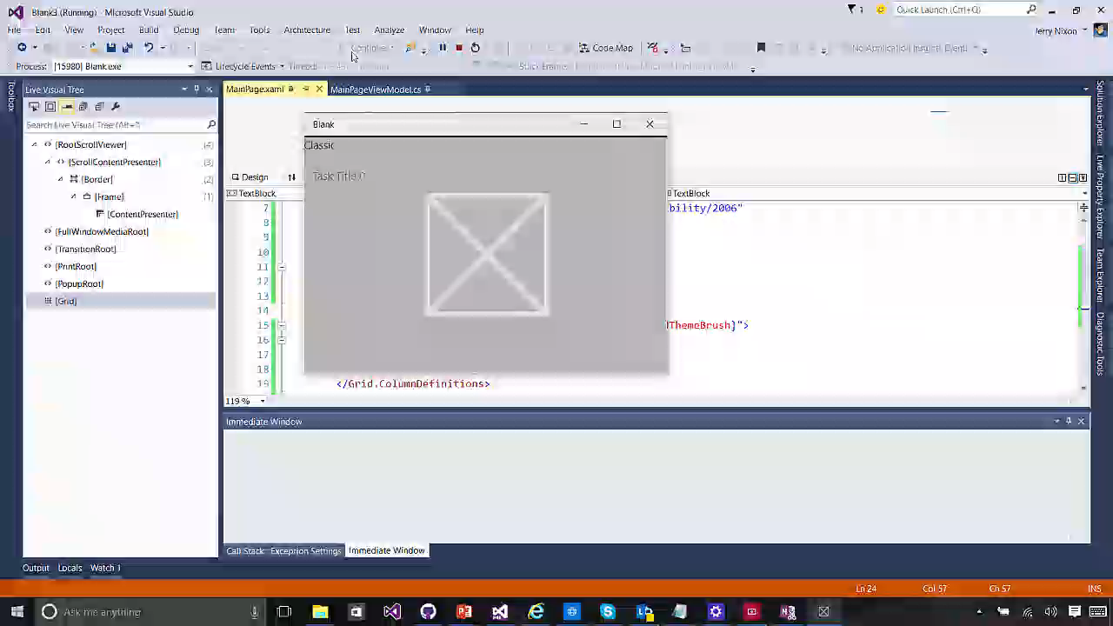

Slide 23
Syntax differences
<ListView ItemsSource="{Binding Items}" Header="Classic" Grid.Column="0">
<ListView.ItemTemplate>
<DataTemplate>
<TextBlock Text="{Binding Title}" />
</DataTemplate>
</ListView.ItemTemplate>
</ListView>
<ListView ItemsSource="{x:Bind ViewModel.Items}" xmlns:m="using:Blank3.Models"
Header="Compiled" Grid.Column="1">
<ListView.ItemTemplate>
<DataTemplate x:DataType="m:TodoItem">
<TextBlock Text="{x:Bind Title}" />
</DataTemplate>
</ListView.ItemTemplate>
</ListView>

Slide 24
Improve performance by simplifying your templates

Slide 25
Resource dictionaries
<ResourceDictionary
x:Class="MyNamespace.MyTemplates"
xmlns:model="using:xBindSampleModel">
<DataTemplate
x:Key="MyTemplate"
x:DataType="model:Employee">
<TextBlock Text="{x:Bind Name}" />
</DataTemplate>
</ResourceDictionary>
namespace MyNamespace
{
public class MyTemplates
{
public MyTemplates()
{
InitializeComponent();
}
}
}

Slide 26
Use Bindings.Update() for async data

Slide 27
Referencing a dictionary
</UserControl.Resources>
<ResourceDictionary>
<ResourceDictionary.MergedDictionaries>
<local:MyTemplates/>
<ResourceDictionary Source="filename" />
</ResourceDictionary.MergedDictionaries>
</ResourceDictionary>
</UserControl.Resources>

Slide 28
Use Bindings.Update() for async data (incl. OneTime)

Slide 29
Binding for Events
<Button Click="PokeEmployee">Poke Employee</Button>
<Button Click="{x:Bind Employee.Poke}">Poke Employee</Button>
Signature
Have no parameters - void Poke()
Match event parameters - void Poke(object sender, RoutedEventArgs e)
Match event base types - void Poke(object sender, object e)
Overloading is not supported
Because all events are eligible:
This may replace ICommand & EventToCommand
Note: this does not include parameter or CanExecute

Slide 30
Bindings.StopTracking() pauses compiled bindings

Slide 31
How do I?
RelativeSource = Self & ElementName
Reference elements by name in Text="{x:Bind MyElement.Text}"
RelativeSource = TemplatedParent
Cannot use x:Bind in control templates; TemplateBinding is already optimized
UpdateSourceTrigger = PropertyChanged
There is UpdateSourceTrigger with x:Bind
Source / DataContext
Add a ViewModel to your code-behind

Slide 32
Page.ViewModel
public sealed partial class MainPage : Page
{
public MainPage()
{
InitializeComponent();
this.DataContextChanged += (s, e) =>
{
ViewModel = DataContext as ViewModels.MainPageViewModel;
};
}
// strongly-typed view models enable x:bind
public ViewModels.MainPageViewModel ViewModel { get; set; }
}

Slide 33
{x:Bind} is not for every situation (yet)

Slide 34
When to use classic binding
Duck Typing
Text=“{Binding Age}” works for both PersonModel & WineModel
Dictionary graphs
Use {Binding} with JSON or other untyped objects
Code-behind binding
Can add/remove {x:Bind} @ runtime
Use in a style
{x:Bind} can’t be used in a style for setters
{x:Bind} can be used in a DataTemplate that is defined in the style

Slide 35
x:Bind can meet your binding needs most of the time.

Slide 36
Data binding basics
Compiled binding

